Slide 1

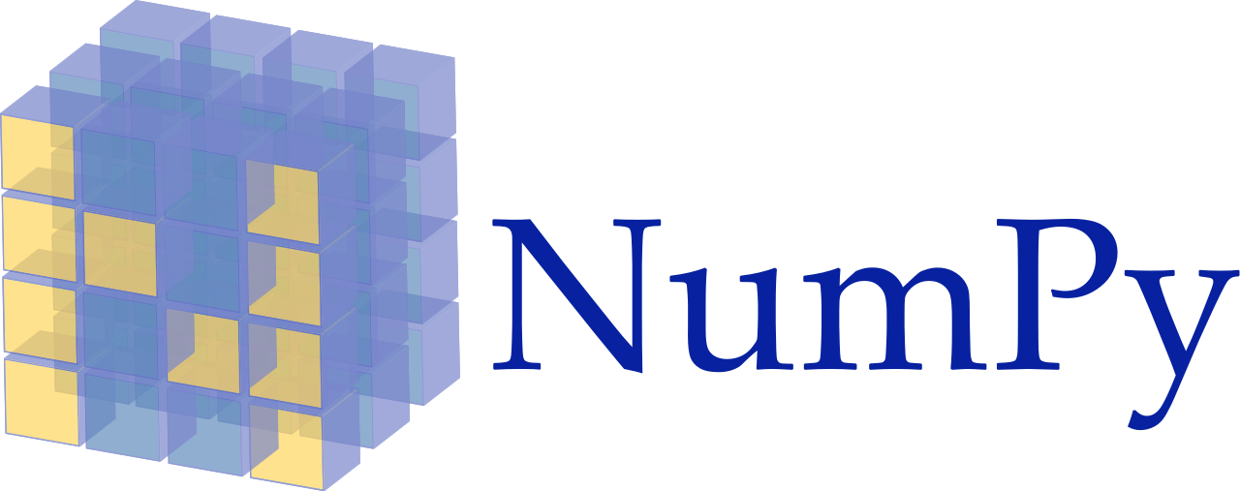

Slide 2
Outline
Introduction
Creating arrays from Existing Data
Array Attributes
Array Operators
NumPy Methods
Shallow Copies
Deep Copies
Universal functions
Indexing and slicing
Reshaping and transposing

Slide 3
Introduction
NumPy (Numerical Python) is a python library used for working with Python arrays.
It offers a high-performance, richly functional n-dimensional array type called ndarray.
NumPy aims to provide an array object that is up to 50x faster that traditional Python lists.
Working domains: Linear algebra, Fourier Transform, and Matrices.
Over 450 Python libraries depend on NumPy.
Popular library: Pandas, SciPy, Keras (Deep Learning Library) depend on NumPy.

Slide 4
Introduction
NumPy arrays support different data types.
NumPy vs. List
NumPy is faster than lists
NumPy data structures take up less space than lists
NumPy have better runtime behavior.
NumPy array need to be declared but lists don’t.

Slide 5
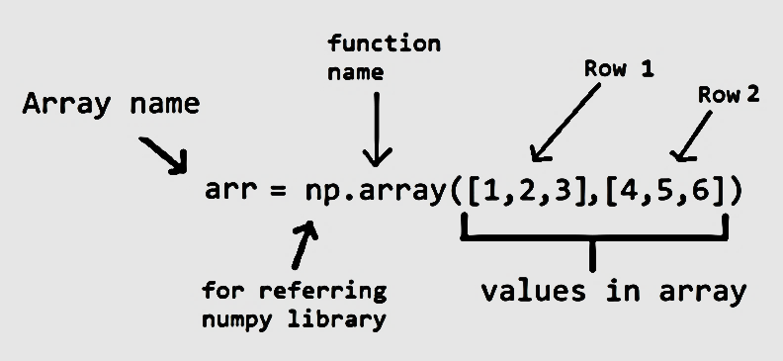


Creating arrays from Existing Data
The NumPy documentation recommends importing the numpy module as np
The numpy module provides various functions for creating arrays.
The array() function, which receives as an argument an array.
NumPy separates each value from the next with a comma and a space and right-aligns all the values.

Slide 6



Creating arrays from Existing Data
Multidimensional Arguments
The array function copies its argument’s dimensions.
NumPy auto-formats arrays, based on their number of dimensions, aligning the columns within each row.
2
4
6
8
Shape(4,)
0
1
1
1
0
1
Shape(3,3)
1
1
0
0
1
1
0
1
1
Shape(3,3,3)
1
0
1
0
1
1
1
0
1
1
1
0
1
0
1
1
1
0
1
1
0

Slide 7
Array Attributes
An array object provides attributes that enable to discover information about its structure and contents.
Some important attributes of this NumPy array.
dtype:- The array function determines an array’s element type from its argument’s elements. For this NumPy array [ [3,4,6], [0,8,1]], dtype will be int64.
ndim:- The attribute ndim contains an array’s number of dimensions. This 2-dimensional array [ [3,4,6], [0,8,1]], value of ndim will be 2.
shape:- It contains a tuple specifying an array’s dimensions. Array [ [3,4,6], [0,8,1]], value of shape will be (2,3).
size:- It can view an array’s total number of elements. for this 2-dimensional array [ [3,4,6], [0,8,1]], size will be multiplication of 2 and 3 (Shape=(2,3)) 2*3 = 6.
itemsize:- the number of bytes required to store each element with itemsize. This NumPy array [ [3,4,6], [0,8,1]], itemsize will be 8, because this array consists of integers and size of integer (in bytes) is 8 bytes.

Slide 8
Array Operators
Operator | Equal Function | Operator | Equal Function
+ | np.add | > | np.greater
- | np.subtract | >= | np.greater_equal
* | np.multiply | < | np.less
/ | np.divide | <= | np.less_equal
// | np.floor_divide | == | np.equal
** | np.power | != | np.not_equal
% | np.mod

Slide 9
NumPy Methods
An array has various methods that perform calculations using its contents. By default, these methods ignore the array’s shape and use all the elements in the calculations. For example, calculating the mean of an array totals all of its elements regardless of its shape, then divides by the total number of elements.
Few NumPy default methods such as sum, min, max, mean, std (standard deviation) and var (variance). Specifying axis=0 performs the calculation on all the row values within each column and axis=1 performs the calculation on all the column values within each individual row.

Slide 10
Shallow Copies
A shallow copy means constructing a new collection object and then populating it with references to the child objects found in the original.
In case of shallow copy, a reference of object is copied in other object. It means that any changes made to a copy of object do reflect in the original object.
2
3
4
5
Array 1
Array 2

Slide 11
Deep Copies
A deep copy constructs a new compound object and then, recursively, inserts copies into it of the objects found in the original.
In case of deep copy, a copy of object is copied in other object. It means that any changes made to a copy of object do not reflect in the original object.
2
2
3
3
4
4
5
5
Array 1
Array 2

Slide 12
End

